Slide 1

SKN Sinhgad Institute of Technology and Science Department of Information Technology
Project Review-I
On
Distance Based Accident Avoidance System Using Arduino with CAN Protocol
by
Roll No | Name
21ITTA21 | Nikhil Dilip Chaudhari
21ITTA12 | Prajakta Mukund Bhand
21ITTA30 | Aishwarya Sandeep Gharat
21ITTA08 | Kunal Chandrashekhar Sonawane
UNDER GUIDANCE
Prof.B.J.Deokate
(Info.Technology Dept.)

Slide 2
Distance Based Accident Avoidance System Using Arduino with CAN Protocol
Project Area : Internet of Things
Sponsorship : -
External Guide : -

Slide 3
Outline
Project Analysis and Design
Data Flow Diagram
UML Diagram
Use case Diagram
Activity Diagram
Class Diagram
Sequence Diagram
Plan of the project – Gantt Chart
Applications
Experimental Result
Conclusion
References
Introduction
Motivation of the Project
Aim and Objective
Problem Statement
Literature Survey
Scope of the project
Preferred Technology
System Requirements
System Architecture
Probable Solution
Module Description

Slide 4
Introduction
Now a day’s road accident is one of the major concerns in our country.
Reckless vehicle driving is the major reason behind those road accidents.
Alarming rate of accidents and uncontrollable car in the road demand an automatic system.
It is very useful to avoid emergency obstacle.
It is very easy to communicate using CAN protocol.

Slide 5
Motivation of the project
Most of the accidents happen due to over speeding to avoid these kind of accidents we implement distance based accident avoidance system.
It is very useful and helpful for commercial transport.
It is also useful for drivers or owner of the vehicle to check whether their vehicle crosses the speed limit on highways.
It is also useful for drivers to check the distance between two vehicles.

Slide 6
Aim and Objective
Aim –
To design and implement system for avoiding the road accidents.
Objectives –
To design a CAN based accident avoidance system.
To set up Ultrasonic sensors and Speed sensor.
To implement control device like Arduino Uno R3 with many onboard interfaces.
To communicate throughout the devices.
To measure distance between two vehicles.

Slide 7
Problem Statement
Globalization and revolution of cities put impacts on infrastructure including road accident.
Number of road accidents are increasing.
To avoid road mishaps, it is not enough to just improve the road conditions, but
also needs to control the traffic accidents.
Distance Based Accident Avoidance System Using Arduino with CAN Protocol

Slide 8
Literature Survey
SR NO. | Title Of Paper | Description With Seed Idea | Techniques Used | Merits/Demerits
1 | Vehicle Speed Control and Accident Avoidance System Based on Arm M4 Microprocessor | The objective of this paper is build an system using to avoid road accidents and to control speed of vehicles. In this paper ARM M4 microprocessor and CAN protocol is used for creating this system. | ARM M4 microprocessor, Arduino UNO, CAN protocol, Ultrasonic sensors, buzzer and LCD display. | Merits: 1)The system can work smoothly in high curve and old bridge. 2)In heavy traffic zone, hospital, school, U-turn etc. vehicles are capable of controlling with the help embedded system.
2 | Smart Vehicle Safety Monitoring System Using CAN Protocol | In this paper CAN protocol, controllers and different sensors are used for creating this system. In case of an impact, this system will service an airbag deployment request. | CAN(Controller Area Network) protocol and controller, Temperature sensor , Obstacle detector, Master controller and Slave controller. | Merits: This system is useful for the safety of passengers.

Slide 9
SR NO. | Title Of Paper | Description With Seed Idea | Techniques Used | Merits/Demerits
3 | Autonomous Test System for CAN-based Automotive Instrument Cluster | In this paper vehicle information like speedometer ,tachometer, fuel gauge ,oil pressure gauge , coolant temperature gauge, warning lights all this information display by the system on instrument cluster. | Autonomous test system and CAN (Controller Area Network). | Merits: All information available on single unit. Demerits: Everyone can’t understand the warning symbols.
4 | MagSpeed: A Novel Method of Vehicle Speed Estimation Through A Single Magnetic Sensor | In this paper, we address the problem of performing accurate vehicle speed estimation in urban environments through a single magnetic sensor. In particular, we develop a vehicle speed estimation technique, MagSpeed, which utilizes normalized and filtered magnetic waveforms to measure vehicle speeds. | Magnetic sensor. | Merits: It easy to detect speed of the vehicle. Demerits: Sometimes magnetic vibrations of the earth is not stable in different places that will effects on the measurement.

Slide 10
SR NO. | Title Of Paper | Description With Seed Idea | Techniques Used | Merits/Demerits
5 | Design of an intelligent autonomous accident prevention, detection and vehicle monitoring system | In this paper an automatic, efficient, low priced and advance system has been developed that can perform this job. This technology prevents the accident and notify the emergency services and the owner of vehicle. | Arduino UNO,GSM model and accelerometer sensor. | Merits: It can detect accident and sends the information to emergency services with covering geographical coordinates. Demerits: It detects acceleration value but in breaking condition it becomes extremely difficult.
6 | Implementation of IN-Vehicle and V2V communication with basic safety message format | Implementation of IN-Vehicle and V2V communication with basic safety message format. | ECU using control area network(CAN). | Merits: The data exchange can be used to detect sudden changes in vehicle that bring about dangerous and thereby warning the driver about it. Demerits: All over implementation is difficult.

Slide 11
SR NO. | Title Of Paper | Description With Seed Idea | Techniques Used | Merits/Demerits
7 | Ultrasonic Sensor based Smart Cap as Electronic Travel Aid for Blind People | The aim of the system is to guide the blind person for movement. For creating this smart cap Arduino uno, ultrasonic sensors ,buzzer and cap are used. | Arduino UNO, Ultrasonic sensors and buzzer. | Merits: This smart cap is very easy to use, cheap, understandable, and easy to access in daily life to blind people.
8 | IOT Based Vehicle Anti-Collision And Pollution Control System | In this paper the system is developed by using Arduino Uno, ultrasonic sensor, hall effect sensor, MQ135 sensor and LCD display. This system alerts the user by blinking the LEDs and displaying the direction of obstacle. | Arduino Uno R3 ,MQ135 sensor, Ultrasonic sensor, Hall effect sensor and LCD display. | Merits: 1)By using this system user can find obstacles and which is useful to prevent the accident and it will help to decrease collision on road. 2) This system indicates pollution level to the driver.

Slide 12
SR NO. | Title Of Paper | Description With Seed Idea | Techniques Used | Merits/Demerits
9 | Comparison Of Linear Displacement Measurements Between A MEMS Accelerometer And HC-SR04 Low-Cost Ultrasonic Sensor | In this paper a food serving robot is created which gives the distance measurement between any obstacle or interference. It also display actual distance between obstacle and robot. | Low cost ultrasonic sensor. | Merits: It is best in performance and reliability of using low cost commercial MEMS accelerometer and ultrasonic sensor. Demerits: It is observe that as a ultrasonic ranger enclosure to the wall. It change the overall loop time.
10 | Implementation of 6LoWPAN and Controller Area Network for a Smart Hydroponics System | In this paper it shows communication between sensors CAN master, CAN slave using 6LoWPAN(Ipv6 over low power WPAN). Also it is used network gateway which act as a interface of the 6LoWPAN system of the cloud. | CAN architecture and Hybrid 6LoWPAN. | Merits: It can easily used and widely accessible. Benefits of the proposed hybrid system.

Slide 13
SR NO. | Title Of Paper | Description With Seed Idea | Techniques Used | Merits/Demerits
11 | Cost minimization of GPS-GSM based vehicle tracking system | In this paper a GPS-GSM based system is designed and implemented to economically track vehicle moving over wide geographical area. | GSM module and Microcontroller. | Merits: A system is proposed to reduced the number and cost of used SMS messages and proposed system also provides of trade-off between cost reduction and tracking accuracy.
12 | Implementation of a speed control system using Arduino | The speed control system used in this project depends on the ultrasonic radar where this radar unit is capable of tracking multiple vehicle together across multiple track. | Speed control system, Ultrasonic sensor and Arduino. | Merits: This system is useful for avoiding the road accident.

Slide 14
SR NO. | Title Of Paper | Description With Seed Idea | Techniques Used | Merits/Demerits
13 | Design of Communication Module of Vehicle Controller Based on ISO26262 Standard | In this project is to improve the safety and reliability of the vehicle controller.It mainly depend on can protocol. | CAN transceiver chip with diagnostic function, NXP’s MPC5604B chip as the master MCU, S12XET256 chip. | Merits: Functional safety objectives and improves the safety and reliability of the vehicle controller.
14 | CAN-Based Networked Path-Tracking Control of a 4WS4WD Electric Vehicle: Maximum Sampling Period | In this project mainly base of path tracing system for electric cars using can protocol. | CAN(Controller Area Network), Networked Control System and 4WS4WD. | Merits: 1)over point-to-point wiring. 2)thereby forming a networked control system (NCS). Demerits: Solving the difficulty of MIMO nonlinear loops.

Slide 15
SR NO. | Title Of Paper | Description With Seed Idea | Techniques Used | Merits/Demerits
15 | Vehicle Avoidance Reaction By Two Step Motion Flow Cluster | This project mainly design for preventing accident and to save the human life. | Cameras and Optical Flow. | Merits: Alarm system, collision avoidance and intelligent collision warning system.
16 | Obstacle detection using ultrasonic sensor for a mobile robot | The project is design to build an obstacle avoidance robotic vehicle using ultrasonic sensors for its movement. | Arduino NANO or Uno (any version)HC-SR04, Ultrasonic Sensor, LM298N Motor Driver Module,5V DC Motors Battery, Wheels Chassis and Jumper Wires. | Merits: 1)IT required less space. 2)IT required less power supply 3)It can easily avoid obstacles. Demerits : limited testing distance.

Slide 16
Scope of the Project
It is useful for commercial cab companies to get the report as per there speed maintaining during transport.
It is useful for cops to get fine directly from cab company.
Using this project we can implement break sensors to overcome emergency.
Distance Based Accident Avoidance System Using Arduino with CAN Protocol

Slide 17
Preferred Technology
For User Interface : GSM(Global System for Mobile Communication) module
System Interface :
Ultrasonic and distance measure sensor :- HC-SR04
16 x 2 LCD Display
CAN protocol Board transmitter and receiver :- MCP 2551
Speed Sensor :- LM393
Alarm :- Buzzer
6. Arduino UNO R3
Distance Based Accident Avoidance System Using Arduino with CAN Protocol

Slide 18
System Requirements
Hardware Requirements :
Arduino UNO R3, CAN board, DC motor, Alarm, LCD display, Power supply, Ultrasonic sensors, Speed sensors, Mobile, GSM SIM.
Software Requirements :
Arduino 1.8.10
Distance Based Accident Avoidance System Using Arduino with CAN Protocol

Slide 19
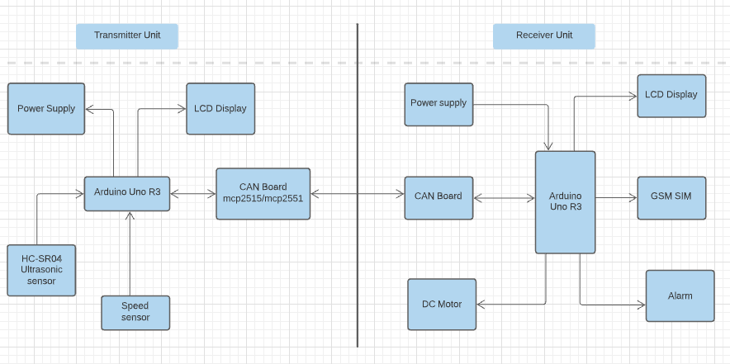
Systems Architecture

Slide 20
Probable Solution
We are using it one transmitter part and one receiver part.
Transmitter part consists of ultrasonic sensor, speed sensor, Arduino uno board,CAN transreceiver/sender board and LCD display.
Receiver part consists of DC motor, GSM module and alarm.
In a transmitter unit on moving vehicle speed sensor will detect the vehicle speed and ultrasonic sensor will detect the obstacle in front of the vehicle.
Then if speed exceed the limit the buzzer will activate and transfer the data from sender module to receiver module through the CAN board.
On the receiver side GSM module will transfer the message to the owner of the vehicle or driver.After that the speed of the vehicle slow down.
Distance Based Accident Avoidance System Using Arduino with CAN Protocol

Slide 21
Module Description
Modules :
1) Transmitter Module
2) Receiver Module
Modules description:
Transmitter Module:
Transmitter part consist of ultrasonic sensor and speed sensor. Ultrasonic sensor detect the obstacle in front of the vehicle and speed sensor detect the vehicle speed and send to the receiver module.
2) Receiver Module :
Receiver part consist of DC motor , alarm and GSM module . DC motor it’s speed control based upon the ultrasonic distance measurement and GSM is a customized global system for mobile communication module is designed for wireless re-adition monitoring through short messaging service. An alarm is used to warn the driver .
Distance Based Accident Avoidance System Using Arduino with CAN Protocol

Slide 22
Project Analysis and Design
Controller Area Network (CAN) : The CAN protocol is a standard designed to allow the microcontroller and other devices to communicate with each other without any host computer. The feature that makes the CAN protocol unique among other communication protocols is the broadcast type of bus.
Ultrasonic Sensor and Speed Sensor : An ultrasonic sensor is an electronic device that measures the distance of a target object by emitting ultrasonic sound waves, and converts the reflected sound into an electrical signal.
GSM (Global System for Mobile Communication) Model : A GSM modem or GSM module is a hardware device that uses GSM mobile telephone technology to provide a data link to a remote network. A GSM module is a chip or circuit that will be used to establish communication between a mobile device or a computing machine and a GSM system.
Distance Based Accident Avoidance System Using Arduino with CAN Protocol

Slide 23

Data Flow Diagram Level 0
Distance Based Accident Avoidance System Using Arduino with CAN Protocol

Slide 24
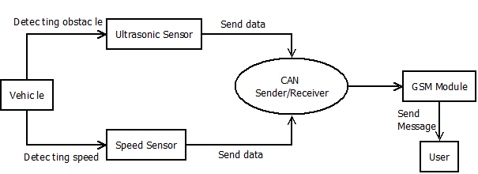
Data Flow Diagram Level 1
Distance Based Accident Avoidance System Using Arduino with CAN Protocol

Slide 25
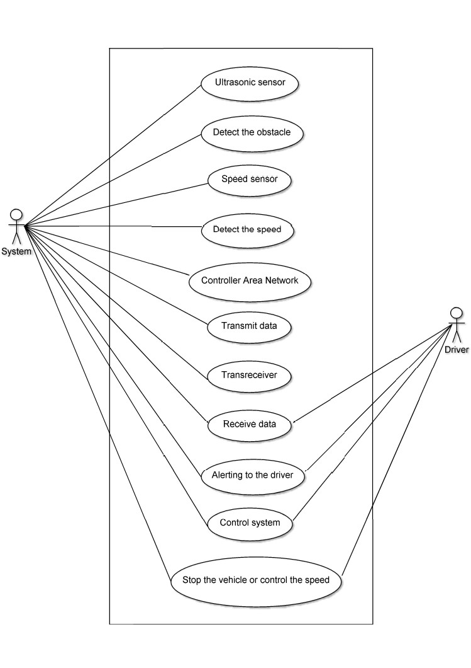
UML Diagram : Use Case Diagram
Distance Based Accident Avoidance System Using Arduino with CAN Protocol

Slide 26
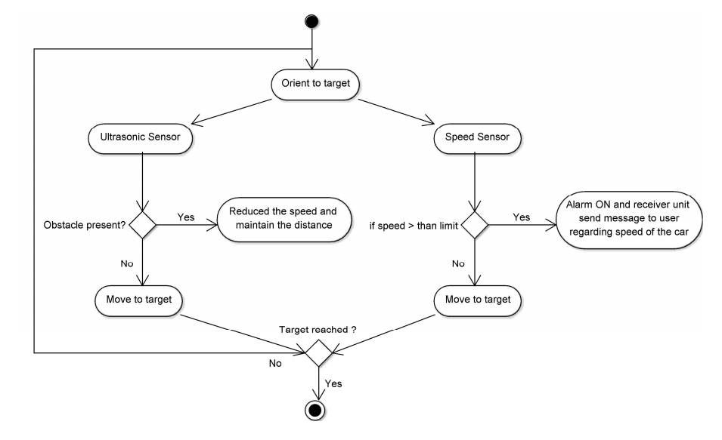
UML Diagram : Activity Diagram
Distance Based Accident Avoidance System Using Arduino with CAN Protocol

Slide 27
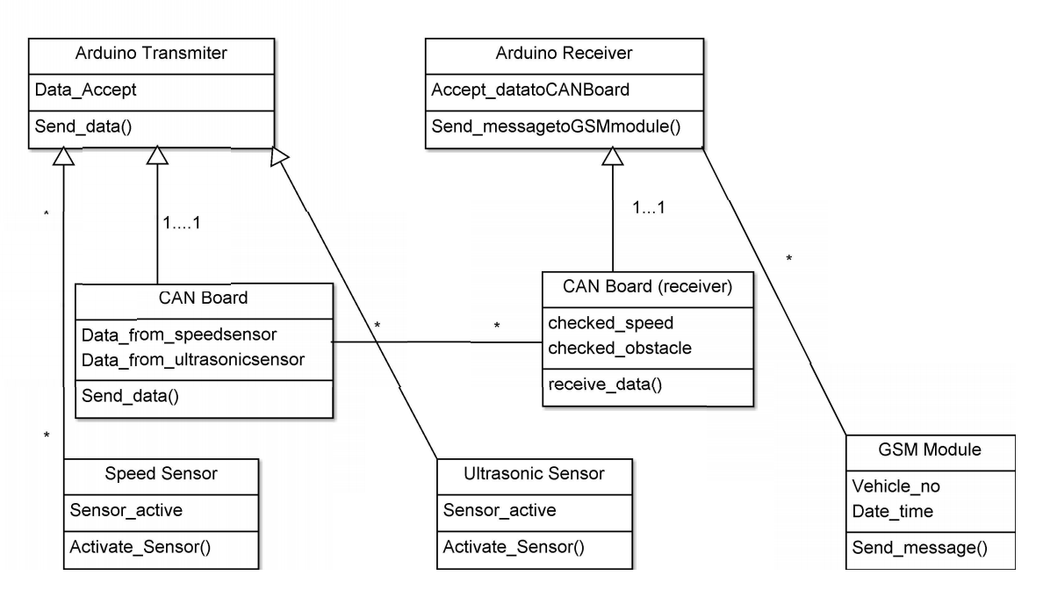
UML Diagram : Class Diagram
Distance Based Accident Avoidance System Using Arduino with CAN Protocol

Slide 28
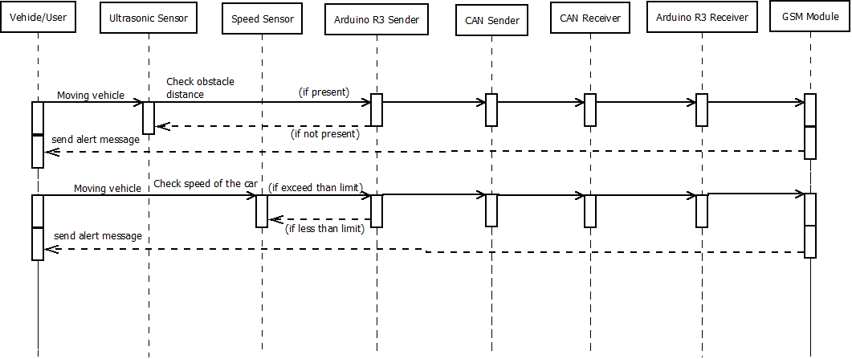
UML Diagram : Sequence Diagram
Distance Based Accident Avoidance System Using Arduino with CAN Protocol

Slide 29
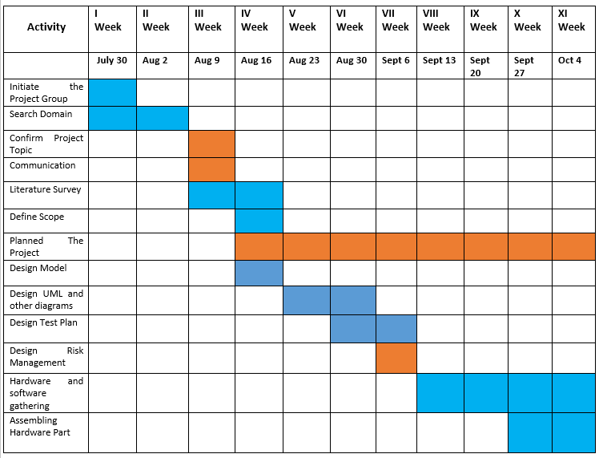
Plan of the project – Gantt Chart

Slide 30
Applications
Used to detect an object in extreme conditions like fog and misty areas.
Used as a warning system to avoid collision in road and highways.
Distance Based Accident Avoidance System Using Arduino with CAN Protocol

Slide 31
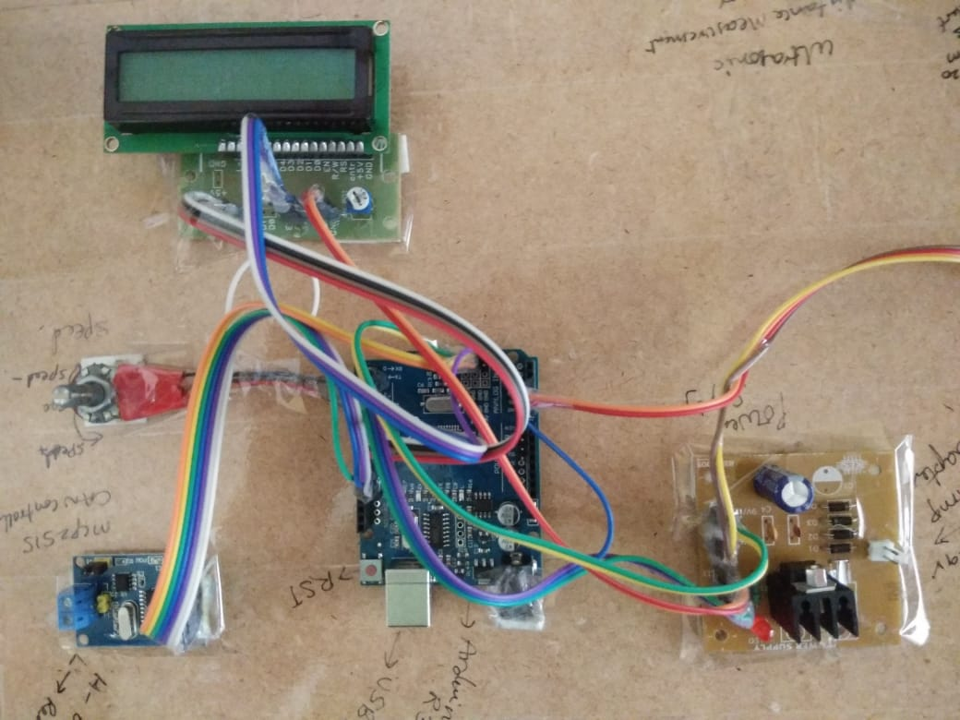
Experimental Results
Distance Based Accident Avoidance System Using Arduino with CAN Protocol

Slide 32
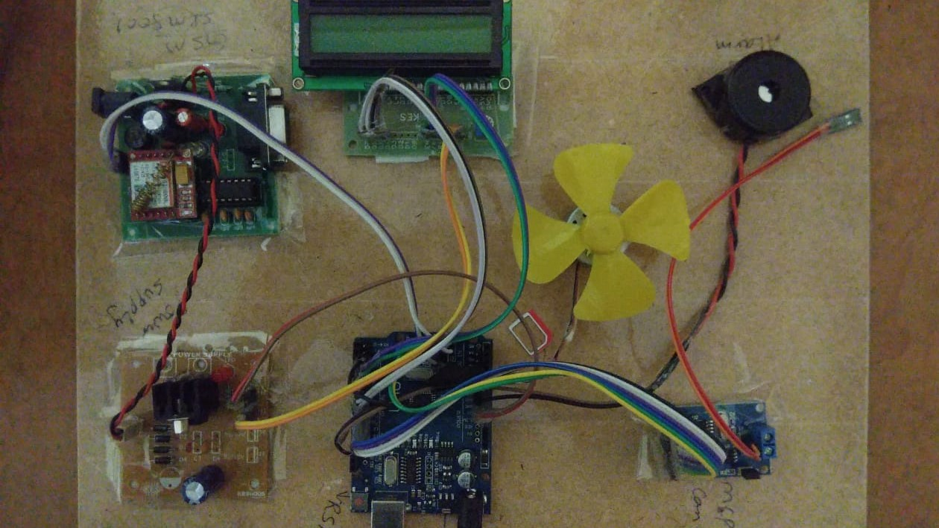
Distance Based Accident Avoidance System Using Arduino with CAN Protocol

Slide 33
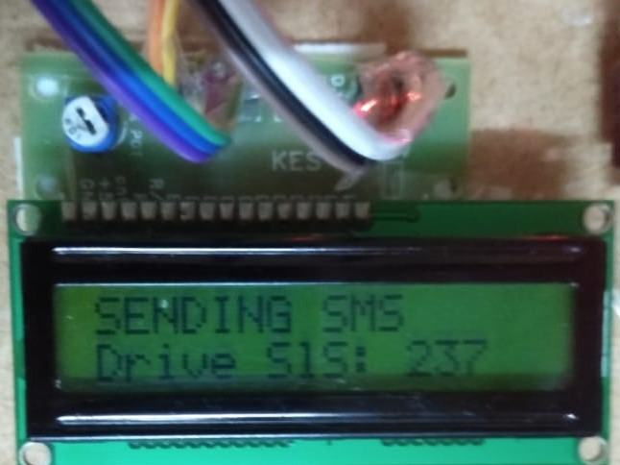
Distance Based Accident Avoidance System Using Arduino with CAN Protocol

Slide 34
Conclusion
From this overall project we conclude that using this technique we can implement the safety measures regarding road transport.
V2V(Vehicle To Vehicle) communication enable intelligent transport system that will provide better vehicle environment.

Slide 35
References
[1] Rachana Khamamka, Ashru Jadhav, Shreyas Thoke, Prof. Girish Chaple,“Smart Vehicle Safety Monitoring System Using CAN Protocol”,
IEEE 2020.
[2] Vipul Parihar, Yogesh Rohilla, Kusum Kumari, “Ultrasonic Sensor based Smart Cap as Electronic Travel Aid for Blind People”, Third
International Conference on Smart Systems and Inventive Technology (ICSSIT 2020) IEEE Xplore Part Number: CFP20P17 ART;ISBN:978-
1-7281-5821-1.
[3] Waladur Rahman, Md. Raseduzzaman Ruman, Khan Roushan Jahan, Md. Jamil Roni, Md. Foyjur Rahman, Md. Abu Hasnat
Shahriar,“Vehicle Speed Control and Accident Avoidance System Based on Arm M4 Microprocessor”, 2020 International Conference on
Industry 4.0 Technology(14Tech) Feb 13-15, 2020.
[4] Abhi B. Amin, Harsh P. Patel, Suken P. Vaghela, Prof. Ronak R. Patel,“IOT Based Vehicle Anti-Collision And Pollution Control System”,
Third International Conference on Electronics Communication and Aerospace Technology[ICECA 2019].
[5] Yi Yun Lau, Muhammad Nasiruddin Mahyuddin, Bakhtiar Affendi Rosdi, Noor Hafizi Hanafi,“Autonomous Test System for CAN-based
Automotive Instrument Cluster”, 4th International Conference and Workshops on Recent Advances and Innovations in Engineering, 27-29
November 2019
[6] Yves Lean Krishner Macayana, Vance Anthony Coronel, Ian Christian Fernandez, Kenneth Ung Carlo Miras, Chris Vincent Densing, Darvy
Ong, Isabel Austria, Marc Talampas Nestor Tiglao, Maria Theresa De Leon, Percival Magpantay Jr., Marc Rosales,“Implementation of
6LoWPAN and Controller Area Network for a Smart Hydroponics System”.

Slide 36
[7] Azmyin Md. Kamal, Salman Habib Hemel, Mohsan Uddin Ahmad,“Comparison Of Linear Displacement Measurements Between A
MEMS Accelerometer And HC-SR04 Low-Cost Ultrasonic Sensor”,1st International Conference on Advance in Science, Engineering
and Robotics Technology 2019(ICASERT 2019).
[8] Yimeng Feng, Guoqiang Mao, Bo Cheng, Baoqi Huang, Shangbo Wang, Junliang Chen,“MagSpeed: A Novel Method of Vehicle
Speed Estimation Through A Single Magnetic Sensor”, 2019 IEEE Intelligent Transportation Systems Conference(ITSC) October 27
-30,2019.
[9] Md Habib Ullah Khan, Md Mamun Howlader,“Design of an intelligent autonomous accident prevention, detection and vehicle monitoring
system”, 2019 IEEE International Conference on Robotics , Automation, Artificial-intelligence and Internet-of-Things(RAAICON)
29 November – 1 December 2019.
[10] Vibin V, Sivraj P, Dr.V.Vanitha, “Implementation of IN-Vehicle and V2V communication with basic safety message format” , International
Conference on Inventive Research in Computing Applications(ICIRCA 2018).
[11] Fatima Nadhim Ameen, Ziad Saeed Mohammed, Abdulrahman Ikram Siddiq,“Cost Minimization of GPS-GSM Based Vehicle Tracking
System”, 2018 International Conference on Advanced Science and Engineering(ICOASE).
[12] Begum Korunur Engiz, Rakan Bashir,“Implementation of a Speed Control System Using Arduino”, 2019 6th International Conference on
Electrical and Electronics Engineering(ICEEE), IEEE 2019.
[13] Anyu Cheng, Lin Qin, Qiuhan Xiong, Youguo Li,“Design of Communication Module pf Vehicle Controller Based on ISO26262 Standard”,
IEEE 2019.
[14] Arun Kant Singh, Ramprasad Potluri, “CAN – Based Networked Path – Tracking of a 4WS4WD Electric Vehicle:Maximum Sampling
Period”, 2018 Indian Control Conference(ICC), IEEE 2018.

Slide 37
[15] Woranon Rassameepaiboon, Wudhichai Assawinchaichote, “Vehicle Avoidance Reaction By Two Step Motion Flow Cluster”, IEEE 2018.
[16] Joseph Azeta, Christian Bolu, Daniel Hinvi, Abiodun A Abioye, “Obstacle detection using ultrasonic sensor for a mobile robot”, 2019 8th
International Conference on Mechatronics and Control Engineering.
Distance Based Accident Avoidance System Using Arduino with CAN Protocol

Slide 38
Any Questions?

Slide 39
Thank You

